Slide 1


KNOWLEDGE INSTITUTE OF TECHNOLOGY
Data-driven Insights on Olympic sport participation and performance
Team Members:
ARUN M (TEAM LEADER)
BHADRIPRASATH B J
DHANASEKARAN B
DHARSHINIPRIYA V

Slide 2
PROBLEM STATEMENT
The objective of this data-driven analysis revolves around gaining a comprehensive understanding of the pivotal factors contributing to success in Olympic Games participation. This involves the meticulous examination of athlete demographics, training techniques, and performance indicators across diverse sports and nations. By harnessing historical Olympic Games data and pertinent sources, our primary aim is to extract valuable insights that can serve as the foundation for enhancing athlete development programs, refining training methodologies, and elevating overall Olympic-level performance. Ultimately, the core purpose of this analysis is to empower athletes, coaches, and sports organizations with data-driven insights to steer them towards greater success on the Olympic stage.

Slide 3
ABSTRACT
The largest and most prestigious international sporting event in the world is the Olympic Games, which include a variety of sports and events. The patterns of participation and performance in various sports can provide crucial information on the elements that influence the success of elite athletes. Using a data-driven technique, this paper analyses historical participation and performance patterns in Olympic sports. The analysis uses a range of data sources, such as historical records of Olympic participation and performance, demographic, and socioeconomic statistics. The analysis reveals numerous important facts about participation in and performance in Olympic sports. It illustrates, for instance, a trend towards more gender diversity in the sports represented as well as a continuous rise in the number of countries competing in the Olympics throughout time. The results show that while some countries have had significant performance variability throughout time, others have consistently performed well in a range of sports. The importance of socioeconomic factors like GDP and population size, together with athlete age and experience, in predicting Olympic performance is also emphasised. Overall, this analysis provides insightful data-driven information about the patterns and trends in Olympic sports performance that can inform strategies for improving athlete development and promoting participation in these sports around the world.

Slide 4
TOOLS USED
IBM Cognos Analytics
IBM Cognos Analytics is a web-based integrated business intelligence suite by IBM. It provides a toolset for reporting, analytics, score-carding, and monitoring of events and metrics. The software consists of several components designed to meet the different information requirements in a company.

Slide 5
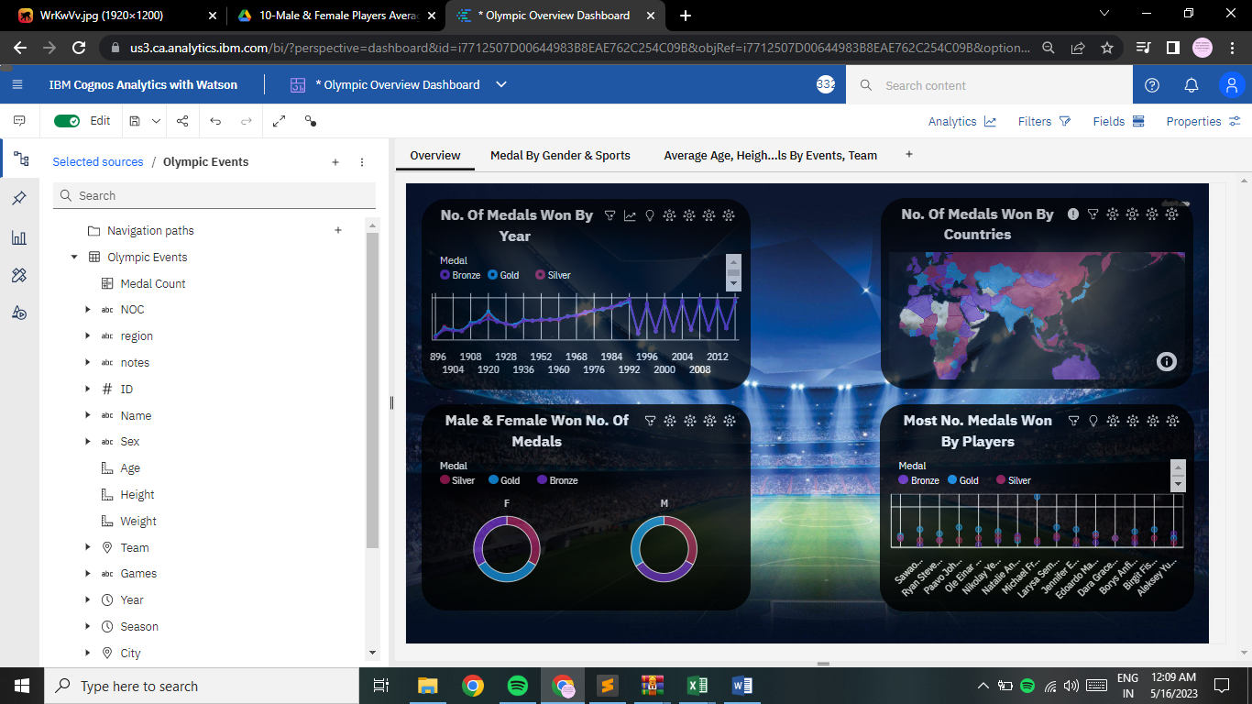
DASHBOARD

Slide 6
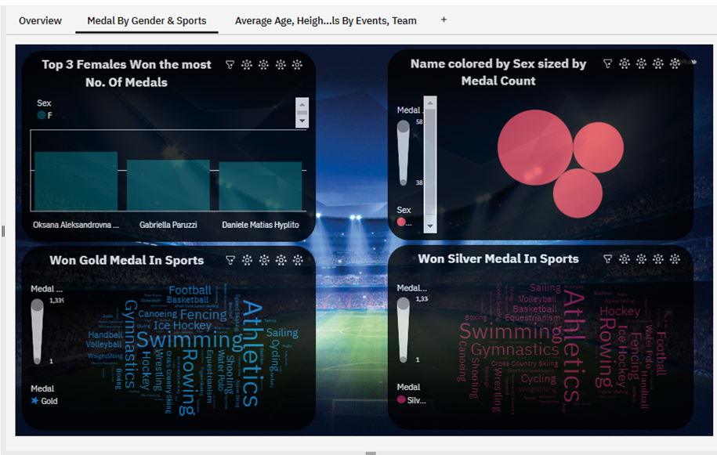
DASHBOARD

Slide 7
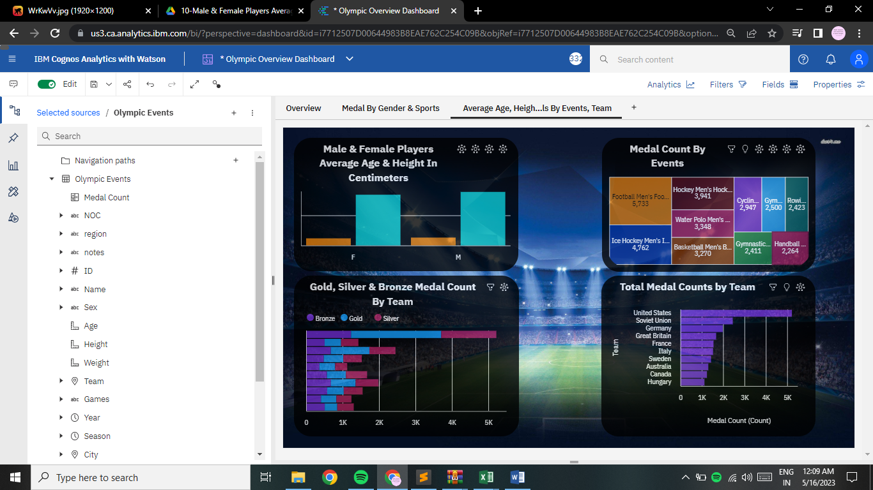
DASHBOARD

Slide 8
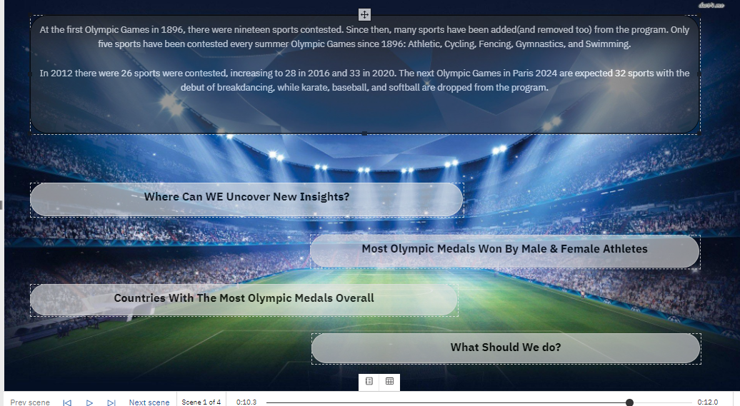
STORY

Slide 9
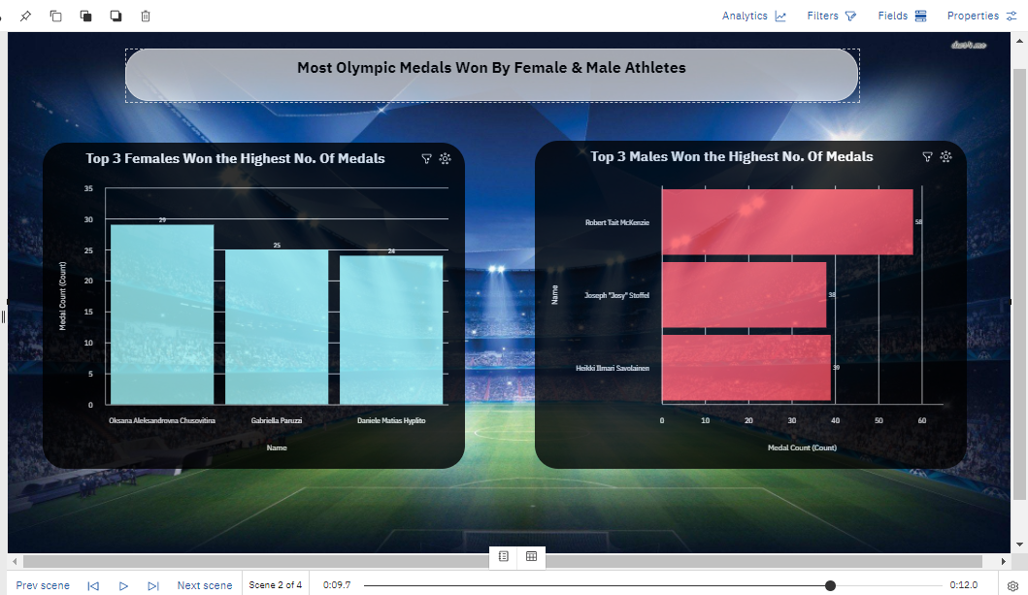
STORY

Slide 10
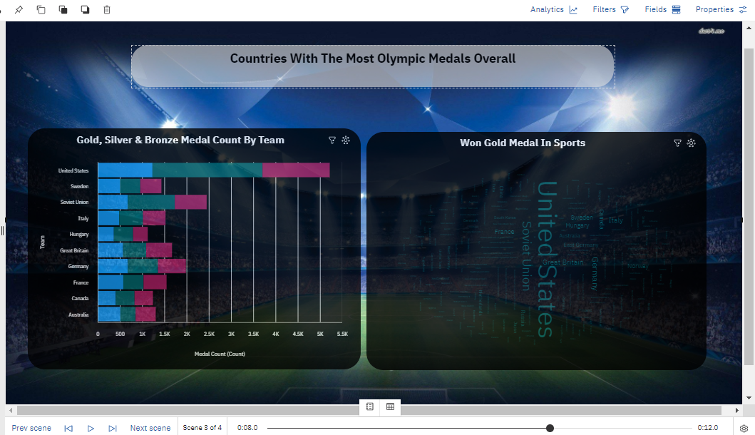
STORY

Slide 11
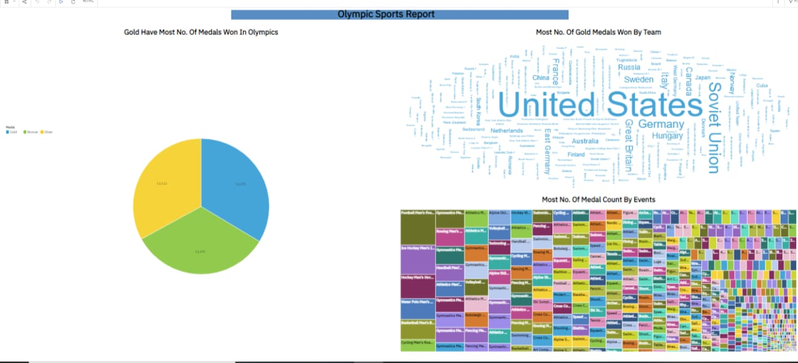
REPORT

Slide 12

WEB INTEGRATION

Slide 13
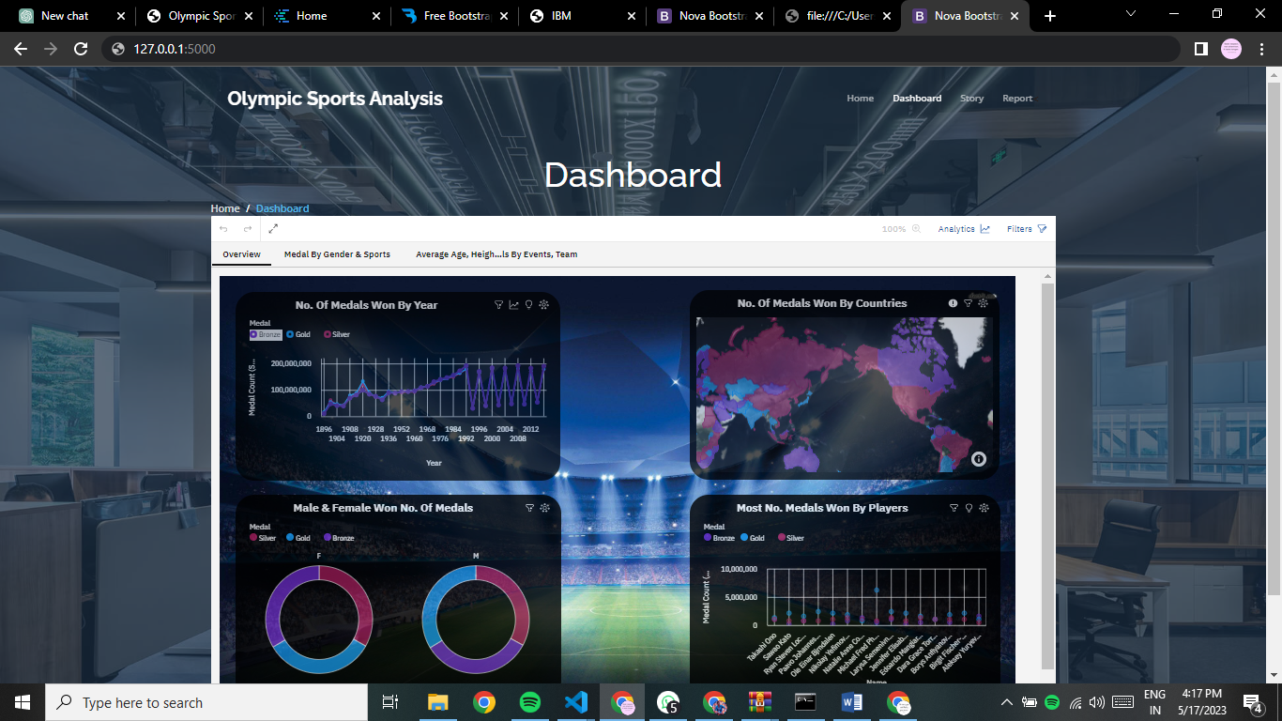
WEB INTEGRATION

Slide 14
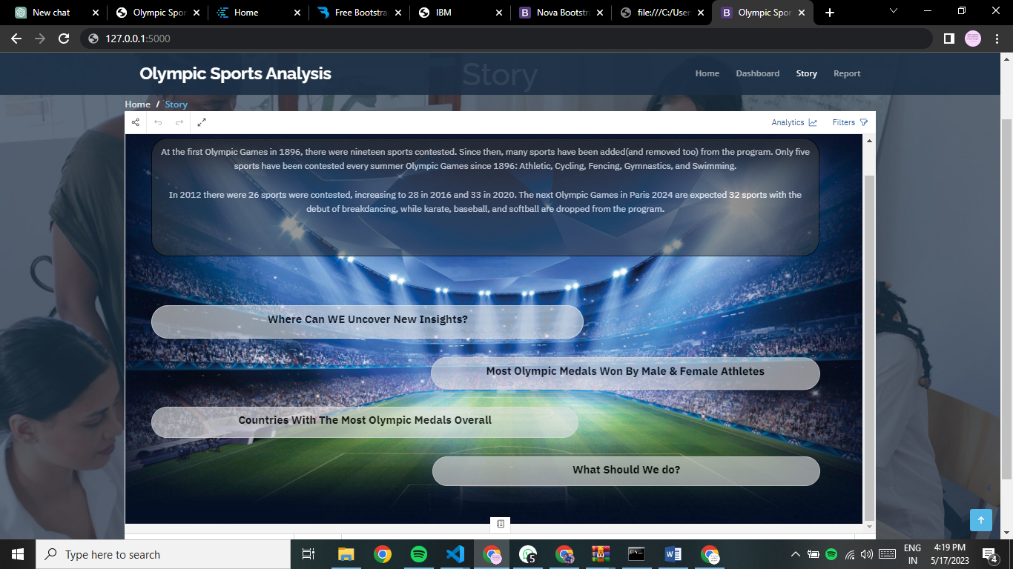
WEB INTEGRATION

Slide 15
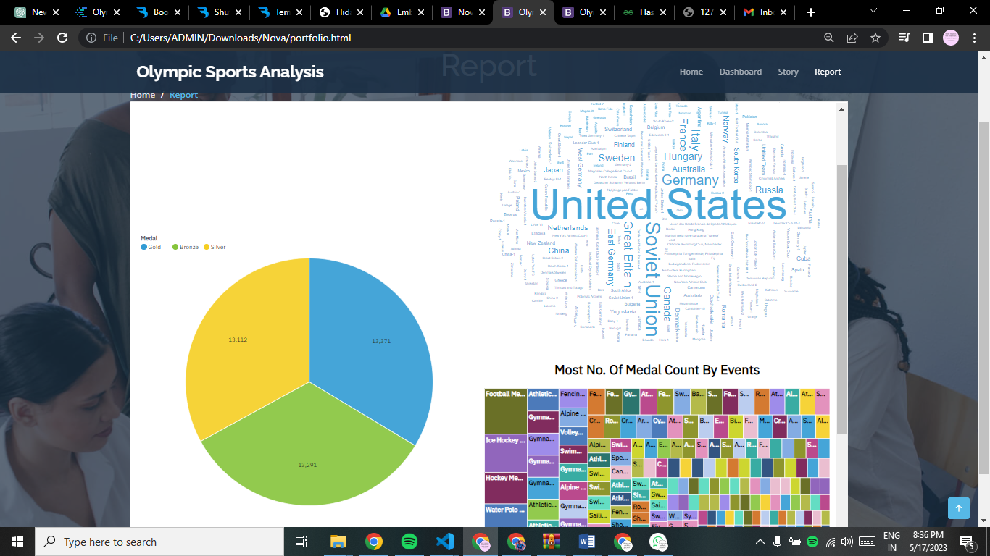
WEB INTEGRATION

Slide 16

WEB INTEGRATION
Video Demonstration For Web Integration Using Flask

Slide 17


